Slide 1
(Best) Practices from hungary (and elsewhere) KICK-OFF MEETING OF THE PROJECT ’TRANSNATIONAL COOPERATION FOR YOUTH PROFESSIONALS’ EFOP-5.2.2-17-2017-00057
Béla Kézy

Slide 2
Practices from hungary (and elsewhere)
Komárom (Hu)
Tatabánya (Hu)
Kazincbarcika (Hu)
Poznan (Pl)
Cesena (It)
Gonesse (Fr)

Slide 3
3
2
1
Understand your city!
Recreation, “third places
Attractive, high quality jobs
3
Digital assets
5
Quality public services
Enterprise support
1
Mobility
Have a clear vision, strategy!
3
Buildings, squares, urban environment
1
2
Professional and social communities
5
2
PLACEMAKING (Urban development)
RETENTION
4
Housing
1
Promote participation!
High quality career orientation
2
Clear proposition
ATTRACTION
DEVELOPMENT
6
Be open to diversity!
4
3
Digital skills at the heart of education
Partnership based marketing and communication
Inspiring digital environment
6
2
”Soft-landing” support
5
Partnership!
Teacher training and retraining
3
5
6

Slide 4
1. Komárom – “Vision workshops”
Context:
Located in Northern Hungary, in the Slovakian-Hungarian border
A city split by the Danube – and the state border
Population: 18.805
Category:
Buildings, squares, urban environment
Vision, strategy
Participation
Activities:
7 ”vision workshops” for residents of various neighbourhoods to identify local values - interactive sessions with experienced moderators;
Drawing-, photo and internet game competition for primary and secondary school students
Online questionnaire on local values
“Local value tours” for schoolchildren
Initial results:
Mobilisation of residents
Common view of local values, inputs to local strategies
Emotional links to the city

Slide 5
2. Tatabánya – concerted actions to retain young people
Context:
Located in Northern Hungary
Population: 65.000
Labour shortage: emigration of young people to Western Europe, higher wages in Slovakia, other Hungarian economic centres
Category:
Attractive, high quality jobs
High quality career orientation
Housing
Partnership-based marketing …
Activities:
Scholarship programme
Internship programme
Housing support (municipal rental apartments)
Coordinated marketing actions – municipality and businesses
Initial results:
Awareness of the problem
Public-private cooperation

Slide 6
3. Kazincbarcika - Kolorcity
Context:
Located in Northern Hungary, heavy industrial past in socialist era
most traditional businesses went bankrupt, very high unemployment, grey, dirty boring city, losing highly educated young people
negative image, no attachment to place
Category:
Attractive, high quality jobs
Recreation, third places
Enterprise support
Partnership-based marketing …
Activities:
Reinventing the city – low-cost solutions to colour buildings, improve public spaces;
Cultural and community programmes
Enterprise support (incubator)
Active communication of the new image
Initial results:
Slowly changing image
Attachment to place, locals are proud of their city
Residents are committed to make Kazincbarcika a better place

Slide 7
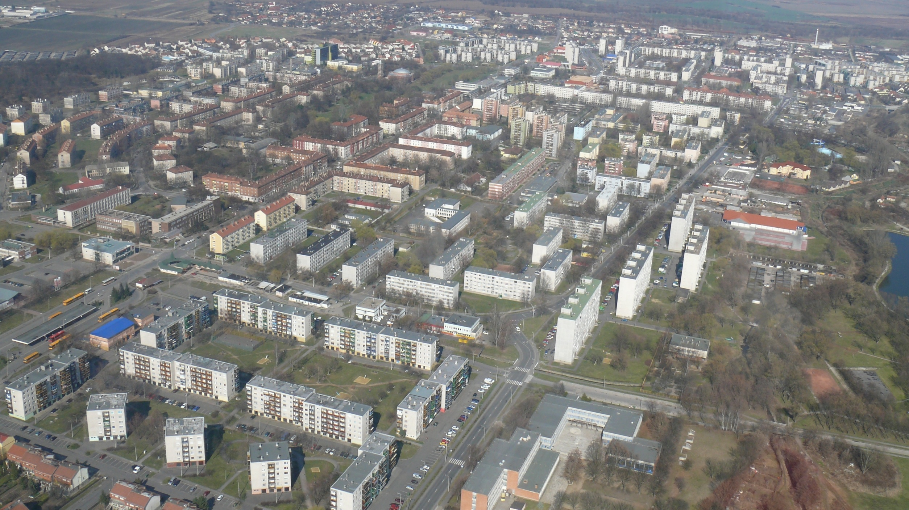

Slide 9
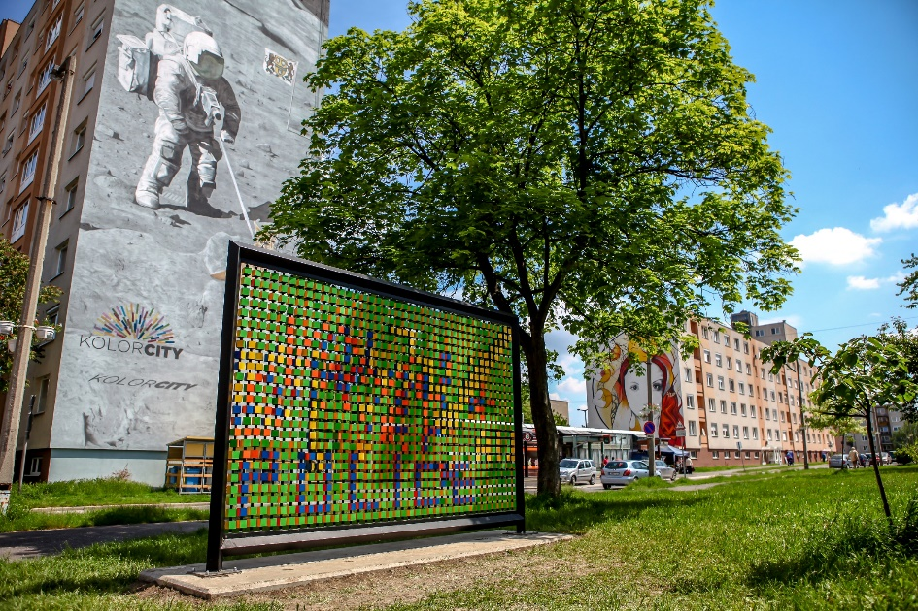
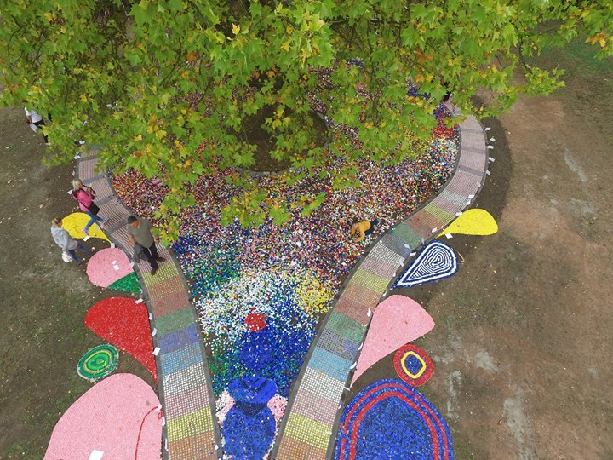
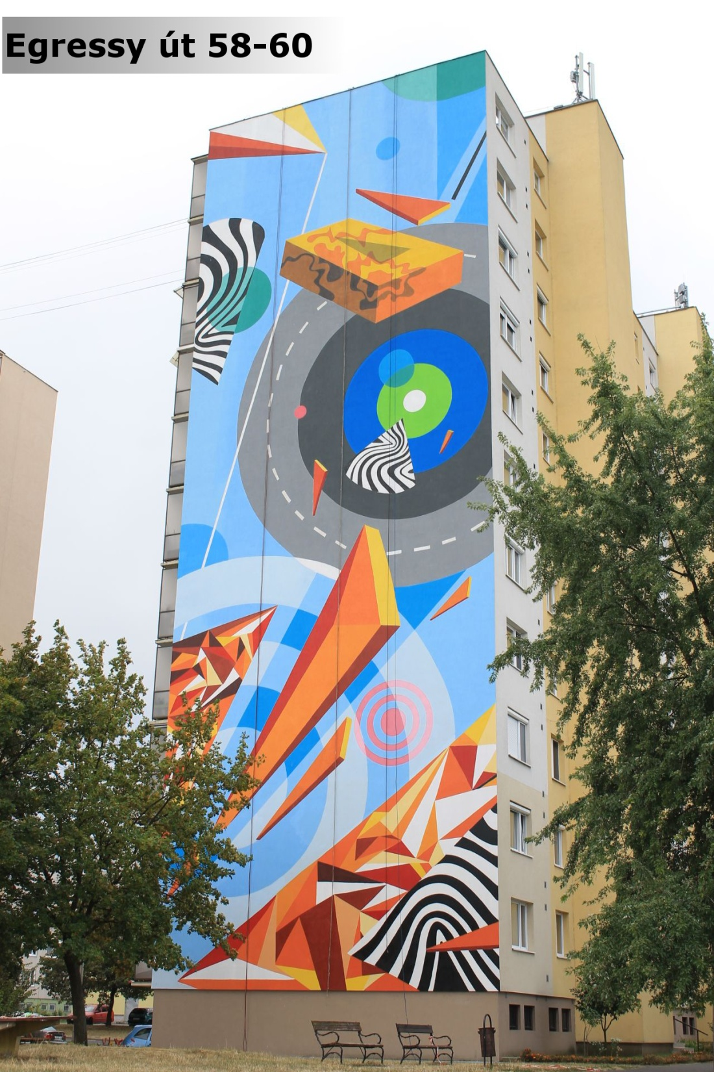
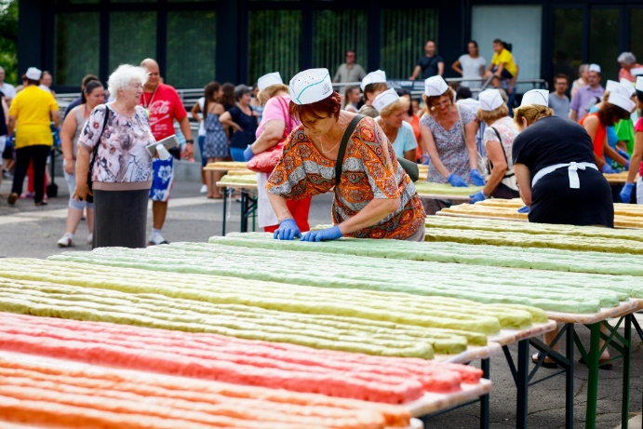
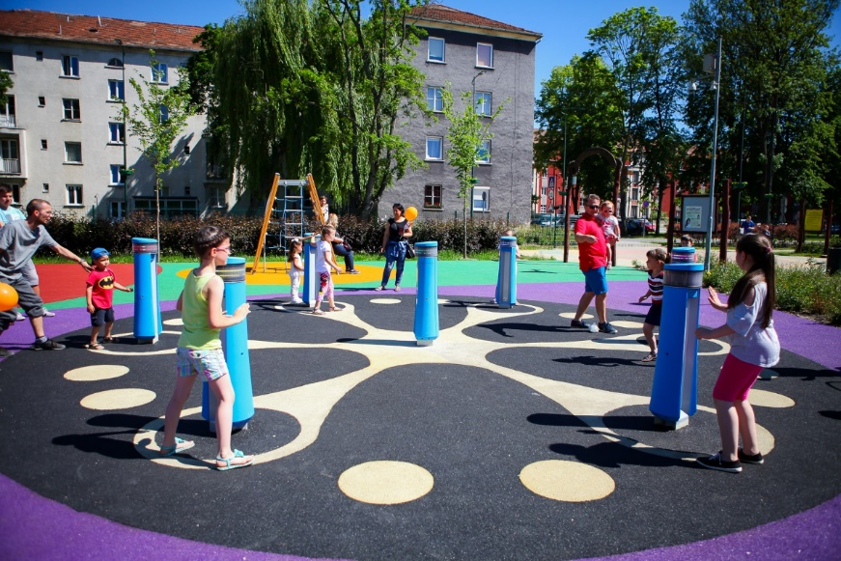
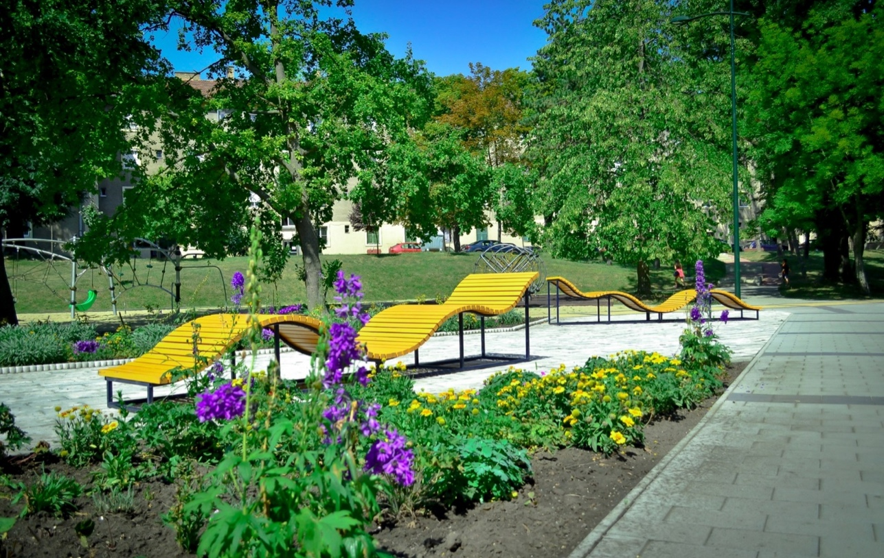

Slide 10
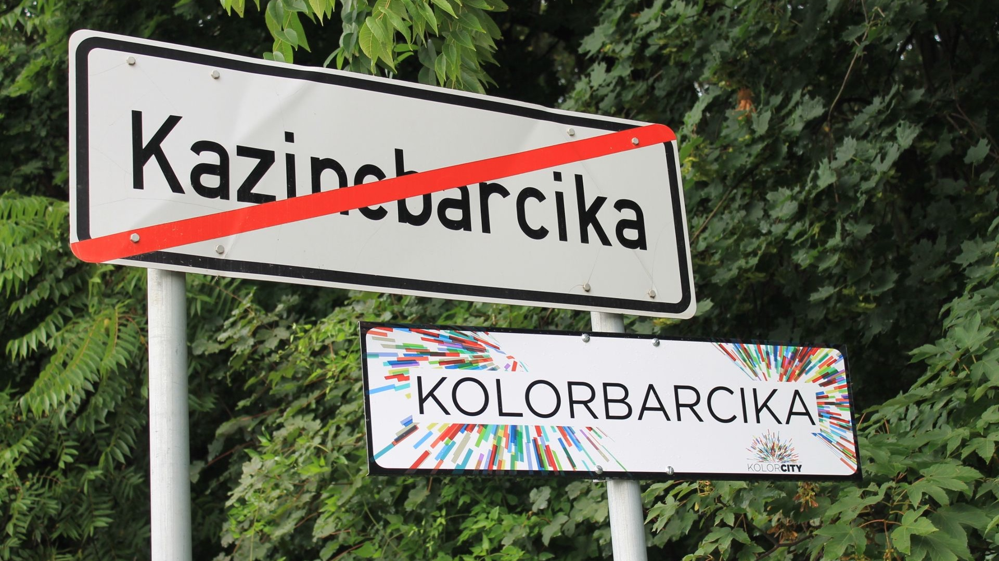

Slide 11
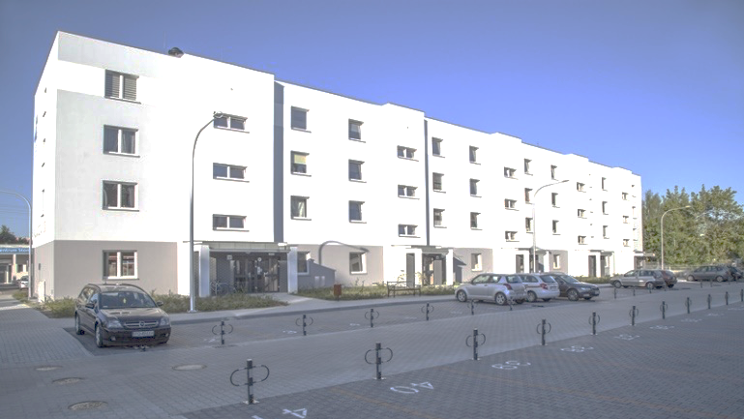
Poznan – housing for young professionals

Slide 12
Cesenalab – start-up centre

Slide 13
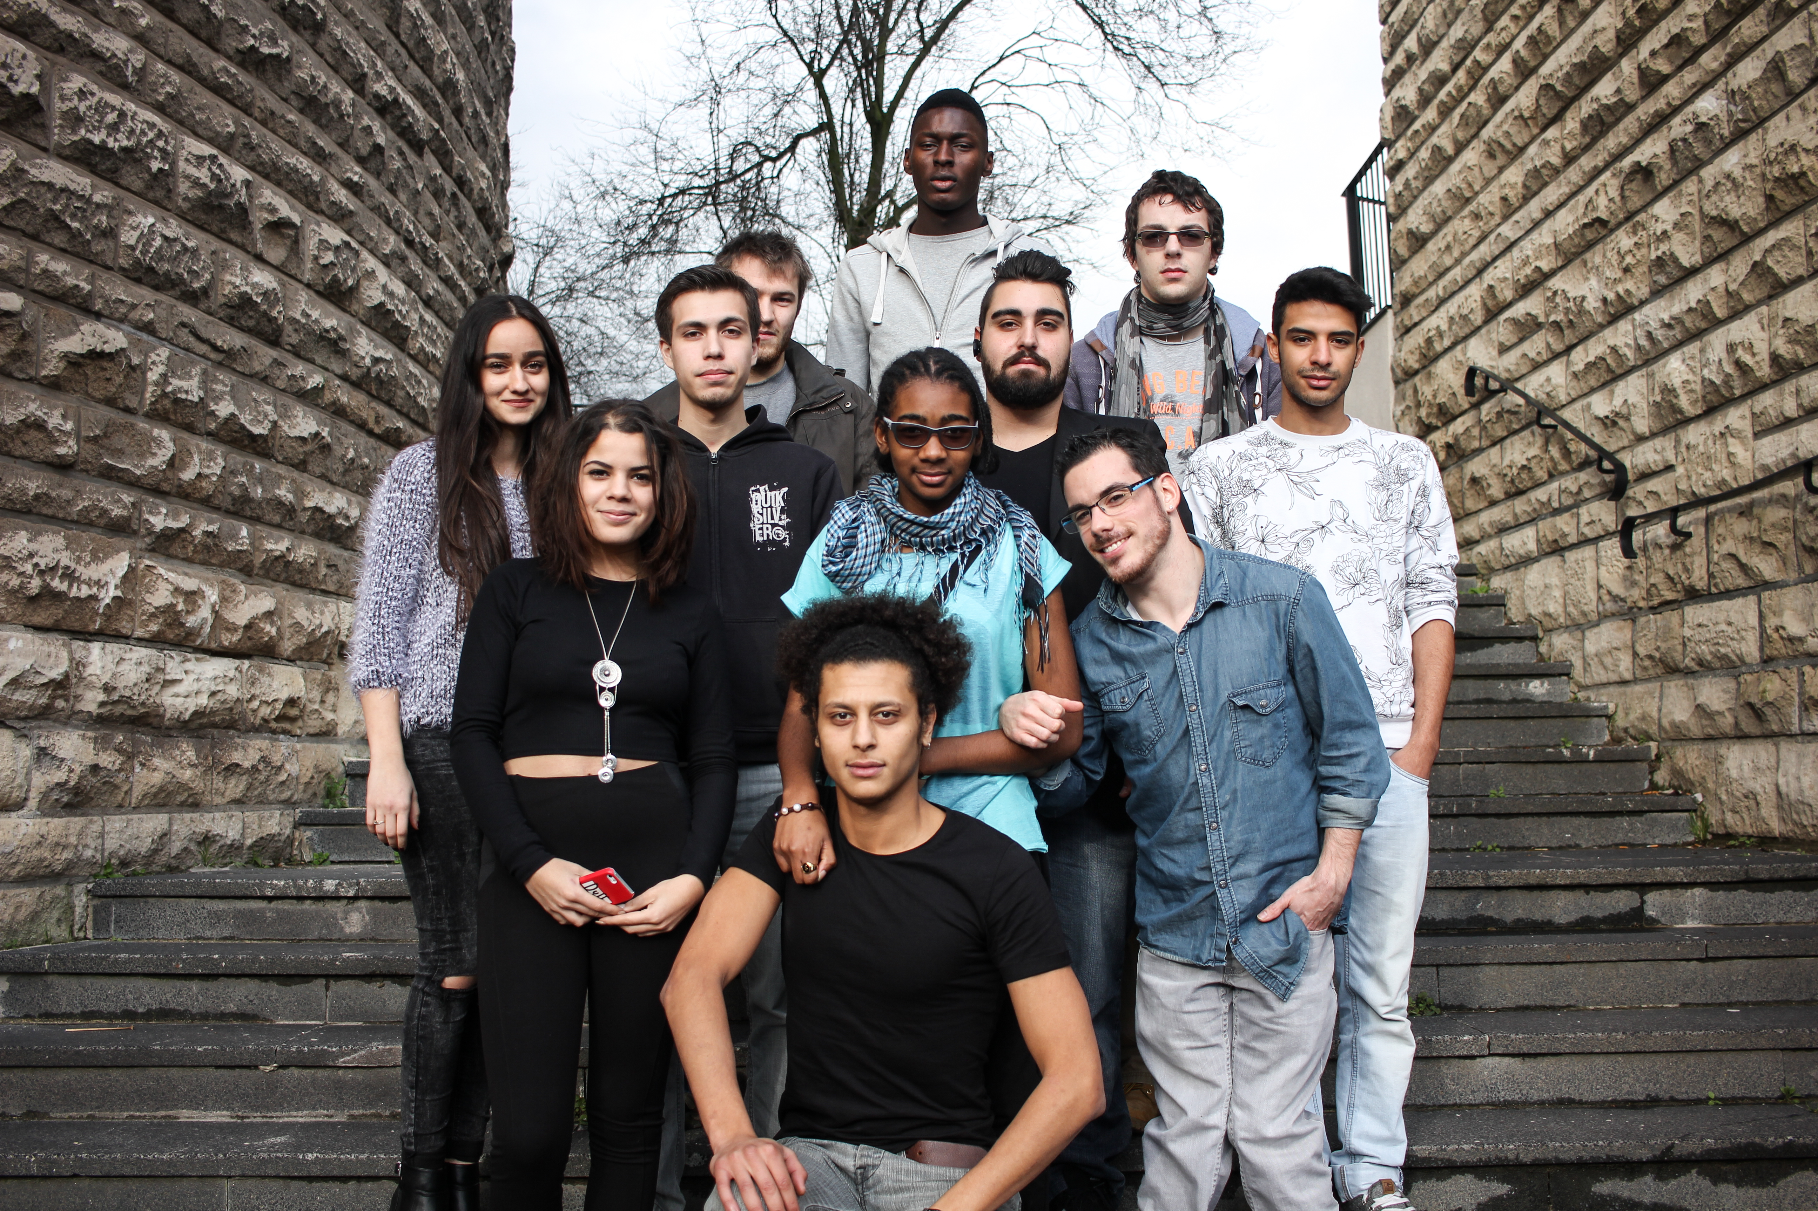
Fablab Gonesse – programme for school dropouts

Slide 14
Key lessons
Understand the local situation!
Ask the young people!
Isolated interventions do not help!
It takes time!
It is not (just) the question of infrastructure!
Creative, low-cost solutions are king!

