Slide 1
Really live in abroad 2 millions of Slovaks?
Transnational cooperation for youth professionals
Miskolc, 28. May 2018
Slavomíra Mareková
Civic Association for Sustainable Development of Slovakia

Slide 2
Estimate in SR
It is estimated that at present in the most important countries - in the Czech Republic, Great Britain, Germany and Austria, work or study something more than 250,000 Slovaks

Slide 3
2 approaches to migration
Migration as an individual strategy
- it is not the benefit for SR
the people do not send the money to
home
Migration as a strategy of family
leave for one week, one month
they bring the money for the family
to Slovakia

Slide 4
Statistics from health insurance in SR
more than half of all those who left the health insurance company were young people under the age of 30
the number of divorces rose sharply after gaining adulthood and culminated in the age of 25, which is the age after college
among the outgoing, they also counted the students who studied abroad, but after the end of the school they found work beyond the borders.
„the most important factor of their departure from Slovakia was high unemployment“

Slide 5
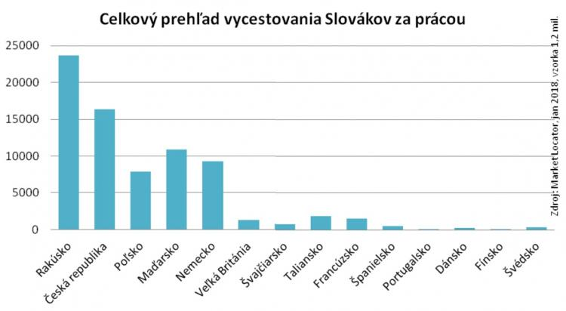
Acording the Market Locator more than 70 000 people from SR work/study in abroad (mobile and table localisation after the Christmas time, on 6 – 12 of January 2018, from 1,2 mil. clients of Slovak Telecom)

Slide 6
Who mostly leave SR?
young people between the ages of 24 and 29 are leaving for work abroad more often than older age groups
long-term unemployed leave less often than those who have been unemployed for only one year
annually completes the study of 20,000 second grade students; twelve to fourteen percent of college graduates traveled beyond the borders
every 5th youth from medical university in SR go to abroad

Slide 7
Where are they?
the most people from SK went to Austria, Austria offer the jobs for nurses, waiters, craftsmen e.g. 40 000 carers (men and women from SK) work in Austria
every 4th Slovak from this sample leaved to CZ
neighbor along the Morava River register about a quarter of a million Slovaks in their territory (students and workers)
11 – 14 % after the Christmas went to Poland (most of Presov region) and Hungary (most from Nitra, Trnava, Kosice region) – daily work
it is more effective to work in Krakow, Budapest, Miskolc, Gyor like Bratislava, Trnava, Nitra
„reason – wages, less free job places“

Slide 8
Study of Slovaks abroad
221 000 students enrolled from the approximate 5.4 million inhabitants of the Slovak Republic, of which 4% were foreign citizens (Eurostat, 2015)
up to 36 000 of our citizens were registered for university studies abroad
it is the third highest share in the European Union countries
the largest number of Slovak students is at our western neighbors – CZ
„the increase in the departure of young people is a long-term trend“

Slide 9
Who study at abroad
on this subject realised the research between the parents whose children attended foreign universities
it was revealed to them that aliens studying from ours come mostly from an environment with a higher level of human capital
nearly half of them are from families where both parents have college education
they were mostly graduates of grammar schools (mostly bilingual) and their ambitions were more related to family backgrounds than to excellent study results, though they did
students, whose both parents have university degrees more often wanted to study far away like e.g. Czech Republic
„study is more attract for youth who have ambitious“

Slide 10
Who return from abroad
less than half of the students studying abroad are two years after their return to Slovakia
at the same time, part of the graduates are back in less than two years after leaving
children from economically stronger families are returning more often to Slovakia after studying abroad, while studying abroad is probably less often for them to work abroad
to Slovakia return more men like women
students who started study after 18. years old stay at abroad more often like the students who started study PhD. at abroad
„mostly return to SR the youth who have a plan other than to work abroad and develop a science career at home “

Slide 11
Recognition of higher education degrees at foreign universities
Only completed III. stage (PhD.) from bilateral agreement with states: CZ, HU, DE, RO, HR, PL
Bc. and Mgr. is acceptable only if this education is equivalent SK education
Mgr. is acceptable only, if this program is 2 years and with diploma work
„education in foreign schools although from prestigious educational schools can do the youth the problems“

Slide 12
Policies in SR
the present regulations of SK policy do not motivate the youth to live in SR
for youth is not important only the wages, or wages of teachers, or the infrastructure of the school, or the job on the ministries, ...
For youth is important:
- respectation of human being (dignity)
- living and working conditions (dignity, freedom)
- and true communication

Slide 13
Thank you for your attention.
Civic Association for Sustainable Development of Regions in Slovakia
Slavomíra Mareková
slavomirama@gmail.com
Mobile: +421 905 597 254

